Slide 1
AWS Virtual Learning Series (EMR)
March 2022

Slide 2
Intro to Amazon EMR (Elastic Map Reduce)
Presented by Fhumulani Nemulodi, EMR Cloud Engineer

Slide 3
Table of contents
What is EMR?
EMR Architecture (Hadoop)
HDFS as a file system
YARN
MapReduce
Benefits of using EMR
EMR use Cases

Slide 4
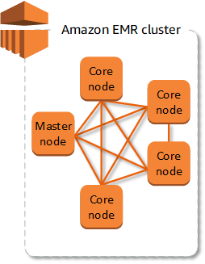
What is Amazon EMR?
Provides a managed Hadoop framework that quickly & cost-effectively process vast amounts of data
Makes it easy, fast & cost-effective for one to process data
Run several popular distributed framework such as Spark

Slide 5
EMR (Hadoop) Architecture
EMR implements managed Hadoop platform to distribute and process vast amounts of data across dynamically scalable Amazon EC2 instances.
Hadoop is an open source frame work that is used to store, process, and analyse chunks of data.
EMR provides easy deployment when compared to on premise clusters.

Slide 6

Hadoop on EMR
HDFS
Yarn (Yet another resource negotiator) for cluster management
MapReduce for data processing
YARN RM
NameNode

Slide 7
Hadoop core components: HDFS
A distributed file system that runs on commodity hardware used for managing and storing data.
Consists of two components namely, name node, and data node.

Slide 8
Hadoop core components: HDFS
How HDFS Stores Files in Blocks
Actor writes a 1GB files to HDFS
The file is broken into blocks of 128MB
These blocks are distributed across all Data Nodes
Replication factor is also important

Slide 9
Hadoop core components: HDFS
How A Read/Write is Handled in HDFS
Client requests file system metadata.
NameNode sends Client the metadata, which includes a list of relevant Data nodes where the data lives.
Client application now communicates directly with the DataNodes to read/write data

Slide 10
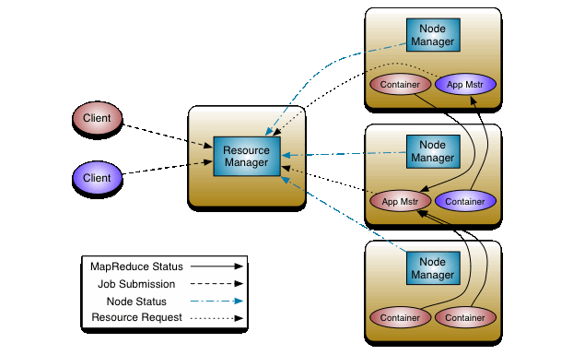
Hadoop core components: YARN
Apache YARN (Yet Another Resource Negotiator) is a resource management.
It makes use of the components namely, resource manager, node manager, application master and containers for job scheduling, processing of activities by allocating resources and scheduling tasks.

Slide 11
Hadoop core components: MapReduce
MapReduce is a framework used for processing huge amounts of data.
It works in two phases, namely, Map and Reduce
For an example MapReduce word count job processes:
Input split (Divide input file)
Mapping (count occurrence)
Shuffling (Group same words together)
Reducing (complete the counting

Slide 12
Benefits of using EMR
Flexible
Low Cost
Secure
Amazon EMR
Elastic
Easy to Use

Slide 13

Benefits of using EMR
Compute Flexibility
General Purpose
Compute Intensive
Memory Intensive
Storage Intensive
M5 Family
M4 Family
M6g Family
C5 Family
C4 Family
C6g Family
X1 Family
R4 Family
R6g Family
D2 Family
I3 Family
Batch Process
Machine Learning
Interactive Analysis
Large HDFS

Slide 14


Leverage Amazon S3 as your persistent data store with EMR File System (EMRFS)
Benefits of using EMR
Support big data frameworks natively (Spark, Hive, Presto, etc.)
Decouple storage and compute
No need to run compute clusters for storage (unlike HDFS)
Can run transient Amazon EMR clusters with Amazon EC2 Spot Instances
Multiple & heterogeneous analysis clusters and services can use the same data
Deliver 99.999999999% durability for stored data
Avoid extraneous data replication cost
Long running Cluster
(Spark-SQL | Presto)
Transient Cluster
(X hours nightly)
Amazon S3
External Metastore
Workload specific clusters
(Different sizes, Different Versions)

Slide 15











Integration with AWS services
Benefits of using EMR
S3 via EMRFS
EBS support for scaling HDFS
Streaming data access to both Amazon Kinesis and Amazon MSK
Amazon KMS for encryption key management
Map Amazon DynamoDB tables with DynamoDB- connector for Hive
Connect to Amazon Redshift through redshift-spark connector
Wrap Amazon EMR cluster with IAM roles for access policies
AWS Glue
AWS Lake Formation

Slide 16

Benefits of using EMR
Secure (authentication)
LDAP
HiveServer2
Presto Coordinator
Spark Thrift Server
Hue Server
Zeppelin Server
EC2 key pair
SSH as “hadoop”
AWS credentials
EMR Step (EMR API)

Slide 17
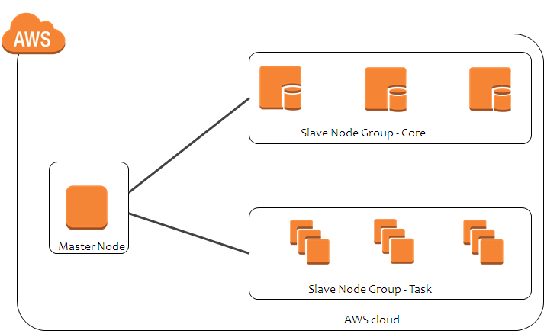
Benefits of using EMR
Completely managed environment for automatically resizing clusters
No configurations required except min/max cost constraints
Can save 20-60% costs depending on the workload pattern
High Resolution Metrics enabled with Managed scaling
Use autoscaling for DIY scaling with custom metrics
Managed scaling for completely managed option
Permanent Nodes
Transient nodes

Slide 18
Lowest Cost
Benefits of using EMR
Less admin time to manage, and support Hadoop clusters
No up-front costs—hardware acquisition, installation
Save on operating costs—data center space, power, cooling
Business Value: Cost of delays, Risk Premium, Competitive abilities, governance, etc.
On-premises
EMR
Support Costs
Subscription Fee
Support Costs
Server Costs
Hardware—Server, Rack, Chassis, PDUs, Tor Switches (+Maintenance)
Software—OS, Virtualization Licenses (+Maintenance)
Network Costs
Network Hardware—LAN Switches, Load Balancer Bandwidth costs
Software—Network Monitoring
IT Labor Costs
Server admin, virtualization admin, storage admin, network admin, support team
Extras
Project planning, advisors, legal, contractors, managed services, training, cost of capital

Slide 19
EMR use Cases
Finance
Security and Law
Government
Retail
Sentiment Analysis
Understanding Customers
Healthcare
Advertisement

Slide 20
EMR use Cases
1. Machine Learning
EMR provides built-in machine learning tools for scalable machine learning algorithms like TensorFLow, Apache Spark MLib, and Apache MXNet. Also you can easily use Bootstrap Actions and Custom AMIs for easily adding the preferred tools and libraries for creating your very own predictive analytics toolset.
2. Extract Transform Load (ETL)
For cost-effective and quick performance of data transformation workloads (ETL) like sort, join and aggregate on large datasets, you can use EMR

Slide 21
EMR use Cases
3. Clickstream analysis
With EMR, along with Apache Hive and Apache Spark, you can segment users, deliver effective ads by understanding the user preferences. All this can be achieved by analyzing the clickstream data from Amazon S3.
4. Real-time streaming
With EMR and Amazon Spark Streaming, analyzing events from Amazon Kinesis, Amazon Kafka or any other streaming data source is possible. This helps in creating highly available, long running, and fault-tolerant streaming data pipelines. Persist transformed insights to Amazon Elasticsearch and datasets to HDFS or Amazon S3.

Slide 22
EMR use Cases
5. Interactive Analytics
With EMR Notebooks, you will be provided with an open-source Jupyter based, managed analytic environment. This will allow data analysts, developers and scientists in preparing and visualizing data, collaborating with peers, building applications, and performing interactive analysis.

Slide 23
Q & A

Slide 24
Thank You!

Slide 25
Introduction to EMR using pyspark
Presented by Wandile Mthethwa, EMR Cloud Engineer

Slide 26
Focus Point
Apache Hive
Hadoop (HDFS)
Yarn Resource Allocation(YARN)
Spark
Jupyter Notebook Attached to EMR
EMR Managed Scaling

Slide 27
Aim of the EMR Demo Session
Purpose of this demo session is to show how pyspark process data on EMR
Create EMR cluster 6.4 version
Create Jupyter Notebook
Allocate Resource to pyspark Job
Analyze and transform data using pyspark
Save transformed data on Hadoop as hive tables

Slide 28

Poll
What is the primary purpose of EMR?

Slide 29
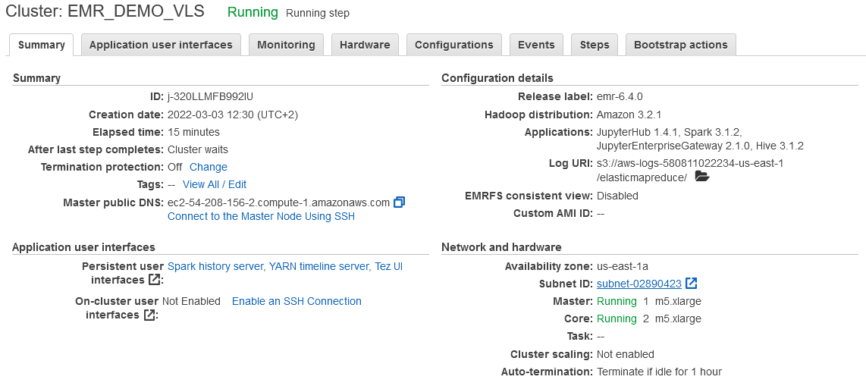
EMR Demo Specification:
EMR 6.4.0
JupyterHub 1.4.1
Spark 3.1.2
JupyterEnterpriseGateway 2.1.0
Hive 3.1.2

Slide 30
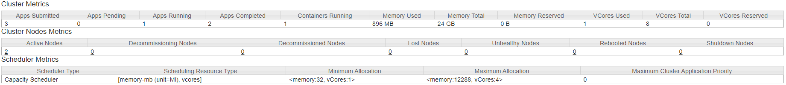
EMR Demo Specification Node Resource:
Core Node:
2 CoreNodes = 8 VCore Total
2 Corenodes = 32 GB Memory – 8GB for Overhead and OS process = 24 GB
m5.xlarge | 4 | 16 | EBS-Only | Up to 10 | Up to 4,750

Slide 31

Poll
How does EMR node scaling help?

Slide 32
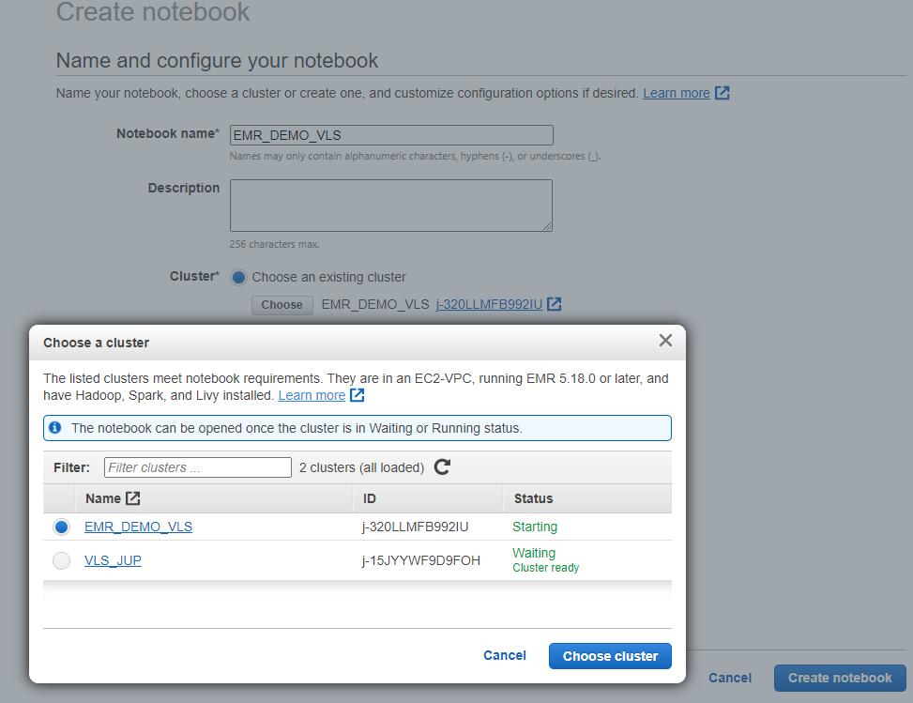
Create Notebook and Attach to Cluster:

Slide 33
EMR Hands-On Demo
Create a spark Session with desired resources on Jupyter
Two census dataset will be used.
We will Analyze and transform the data.
Write the analyzed data as hive tables.

Slide 34
Poll
Does EMR store data?

Slide 35
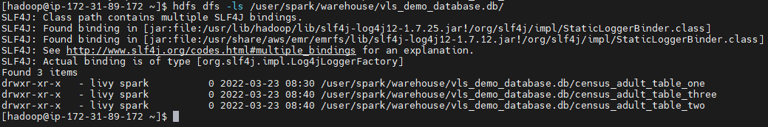
Hadoop data location.

Slide 36
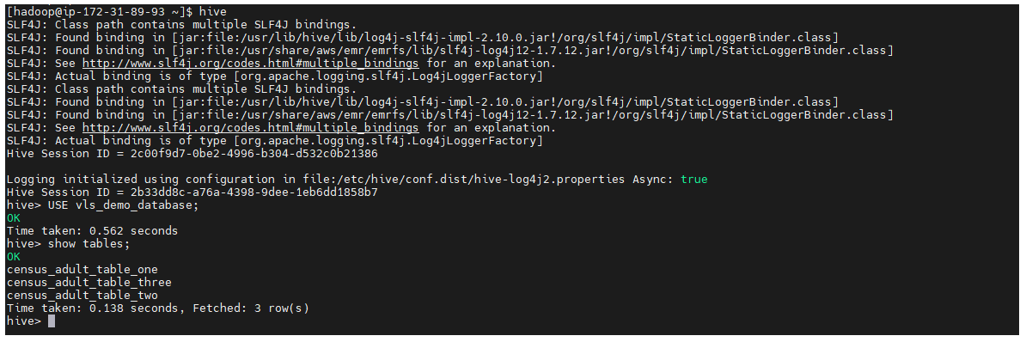
Hive Table

Slide 37
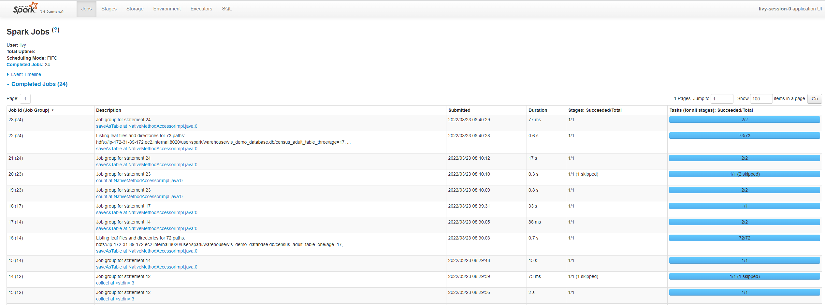
Spark History Server.

Slide 38
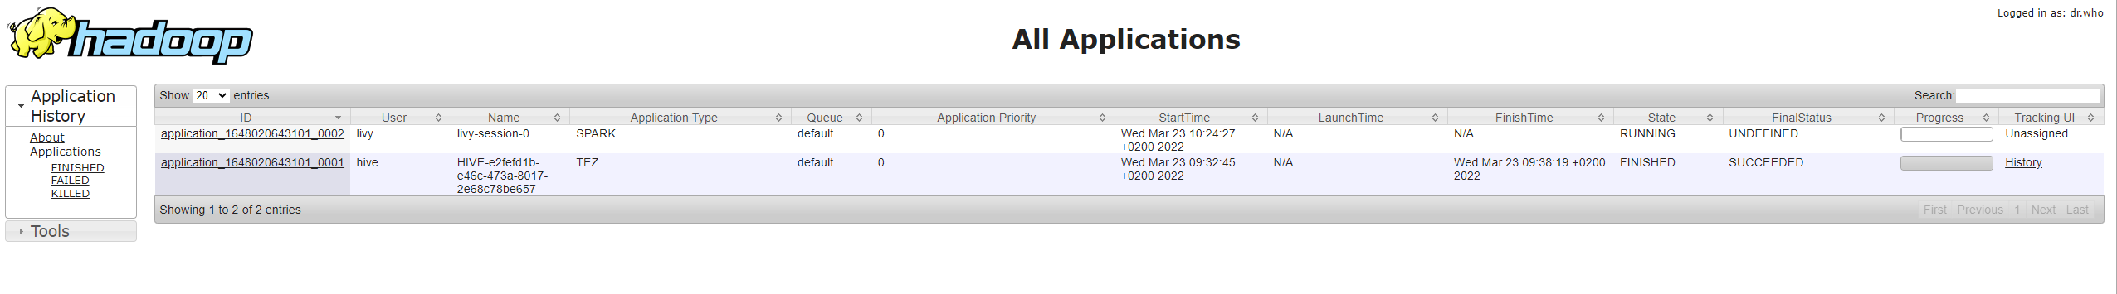
YARN timeline Server

